Slide 1
SOLID PRINICPLES

Slide 2
SOLID PRINCIPLES
SOLID Principles are five principles of Object-Oriented class design. They are a set of rules and best practices to follow while designing a class structure.

Slide 3
SOLID PRINCIPLES
The Single Responsibility Principle
The Open-Closed Principle
The Liskov Substitution Principle
The Interface Segregation Principle
The Dependency Inversion Principle

Slide 4
The Single Responsibility Principle
The Single Responsibility Principle states that a class should do one thing and therefore it should have only a single reason to change
To state this principle more technically: Only one potential change (database logic, logging logic, and so on.) in the software’s specification should be able to affect the specification of the class.
This means that if a class is a data container, like a Book class or a Student class, and it has some fields regarding that entity, it should change only when we change the data model.

Slide 5
Single Responsibility Principle
Following the Single Responsibility Principle is important. First of all, because many different teams can work on the same project and edit the same class for different reasons, this could lead to incompatible modules.
Second, it makes version control easier. For example, say we have a persistence class that handles database operations, and we see a change in that file in the GitHub commits. By following the SRP, we will know that it is related to storage or database-related stuff.

Slide 6
Single Responsibility Principle
Merge conflicts are another example. They appear when different teams change the same file. But if the SRP is followed, fewer conflicts will appear – files will have a single reason to change, and conflicts that do exist will be easier to resolve.

Slide 7
Open-Closed Principle
The Open-Closed Principle requires that classes should be open for extension and closed to modification
Modification means changing the code of an existing class, and extension means adding new functionality.

Slide 8
Open-Closed Principle
So what this principle wants to say is: We should be able to add new functionality without touching the existing code for the class. This is because whenever we modify the existing code, we are taking the risk of creating potential bugs. So we should avoid touching the tested and reliable (mostly) production code if possible.
But how are we going to add new functionality without touching the class, you may ask. It is usually done with the help of interfaces and abstract classes.

Slide 9
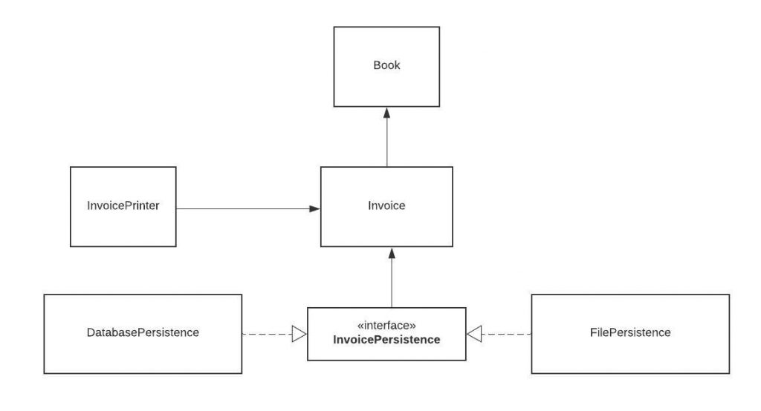
OPEN CLOSED PRINCIPLE

Slide 10
Liskov Substitution Principle
The Liskov Substitution Principle states that subclasses should be substitutable for their base classes.
This means that, given that class B is a subclass of class A, we should be able to pass an object of class B to any method that expects an object of class A and the method should not give any weird output in that case

Slide 11
Liskov Substitution Principle
This is the expected behavior, because when we use inheritance we assume that the child class inherits everything that the superclass has. The child class extends the behavior but never narrows it down.
Therefore, when a class does not obey this principle, it leads to some nasty bugs that are hard to detect.

Slide 12
Interface Segregation Principle
The Interface Segregation Principle (ISP) states that a client should not be exposed to methods it doesn’t need. Declaring methods in an interface that the client doesn’t need pollutes the interface and leads to a “bulky” or “fat” interface

Slide 13
Dependency Inversion Principle
Dependency Inversion principle states that our classes should depend upon interfaces
These two principles are indeed related and we have applied this pattern before while we were discussing the Open-Closed Principle.
We want our classes to be open to extension, so we have reorganized our dependencies to depend on interfaces instead of concrete classes. Our PersistenceManager class depends on InvoicePersistence instead of the classes that implement that interface or abstract classes instead of concrete classes and functions.

Slide 14
Thank you!!

